Slide 1

Conversation Patterns in Autogen
Apoorv Vishnoi
Head of Training, Analytics Vidhya

Slide 2
In-Air

Slide 3
Conversation Patterns
Define how agents interact with each other
Notes:
Conversation patterns define how agents interact with each other.

Slide 4
Conversation Patterns
Define how agents interact with each other
Determine flow of communication
Create Agents to execute adaptable workflow
Notes:
They determine the flow of communication and collaboration in multi-agent systems. By understanding these patterns, you can create agents that can collaborate to execute adaptable workflows for tasks like personal assistance, customer support, and customized guidance.

Slide 5
Conversation Patterns
Conversation Patterns
Two Agent Chat
Sequential Chat
Group Chat
Nested Chat
Notes:
AutoGen offers four main conversation patterns - Two Agent Chat, Sequential Chat, Group Chat, and Nested Chat. Let us start with the first one.

Slide 6
Two Agent Chat
Agent B
(Recipient)
Initializer
Initial Message
History
Summarizer
Chat Result
Max Turn
Agent A
(Sender)
Notes:
Two-agent chat is the simplest conversation pattern where two agents exchange information. This form is ideal for direct communication between two distinct roles.

Slide 7
Two Agent Chat
Agent B
(Recipient)
Initializer
Initial Message
History
Summarizer
Chat Result
Max Turn
Agent A
(Sender)
Notes:
Two-agent chat is the simplest conversation pattern where two agents exchange information. This form is ideal for direct communication between two distinct roles.

Slide 8
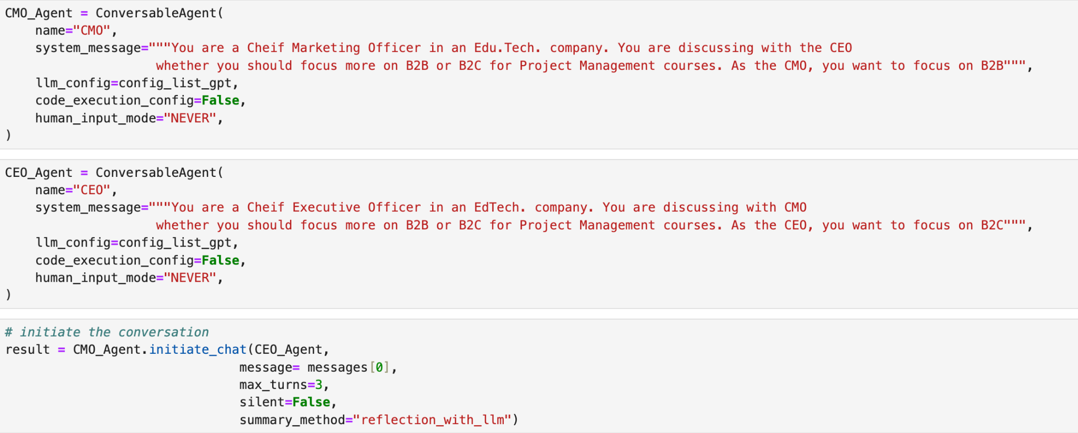
Two Agent Chat
Notes:
In fact the business conversation agent that we built in the last module is an example of a Two-Agent chat. Now that we have understood how a two-agent chat works, let’s look at a few areas where a two agent conversation pattern is particularly useful.

Slide 9
Reflection-Based Systems
Agent A creates content; Agent B reviews it
Notes:
Number 1: Reflection-Based Systems: In these systems one agent creates content and the other reviews and suggests improvements.

Slide 10
Reflection-Based Systems
Agent A creates content; Agent B reviews it
Creative Agent
Initializer
Initial Message
History
Summarizer
Chat Result
Max Turn
Critic Agent
Notes:
For Example: A Creative Agent proposes product names, and a Critic Agent provides feedback to create a refined list.

Slide 11
Role-Based Simulations
Agents mimic real-world scenario to test workflows
Notes:
Number 2: Role-Based Simulations: Here agents mimic real-world scenarios to test workflows like customer interactions.

Slide 12
Role-Based Simulations
Agents mimic real-world scenario to test workflows
Support Agent
Initializer
Initial Message
History
Summarizer
Chat Result
Max Turn
Customer Query Agent
Notes:
For Example: A Customer Query Agent interacts with a Support Agent to resolve product questions.

Slide 13
Debating Ideas
2 Agents play debate against each other
Notes:
Number 3: Debating Ideas: two agents perform critical analysis by arguing opposing perspectives.

Slide 14
Debating Ideas
2 Agents play debate against each other
Defendant Agent
Initializer
Initial Message
History
Summarizer
Chat Result
Max Turn
Prosecutor Agent
Notes:
For Example: A Prosecutor Agent builds a case against a defendant agent which highlights loopholes in that case.

Slide 15
Task Management
2 Agents break down complex decisions into manageable steps
Notes:
Number 4: Task Management: two agents break down complex decisions into manageable steps through collaboration.

Slide 16
Task Management
2 Agents break down complex decisions into manageable steps
Executor Agent
Initializer
Initial Message
History
Summarizer
Chat Result
Max Turn
Task Manager Agent
Notes:
For Example: A Task Manager Agent provides a defined structure to perform a task, and an Executor Agent performs the tasks specified. These applications showcase the versatility of two-agent systems in streamlining communication and decision-making across business functions.

Slide 17
Task Management
Conversation Patterns
Conversation Patterns
Two Agent Chat
Sequential Chat
Group Chat
Nested Chat
Notes:
Now that we understand the Two_agent Conversation Pattern, let’s look at the next conversation pattern, which is, Sequential Chat,

Slide 18
Task Management
Sequential Chat
Agent B
(Assistant Agent)
Agent C
(Conversable Agent)
Agent D
(Assistant Agent)
Initial Message
Context
Context
Context
Chat Result
Summarizer
Carryover
Carryover
Carryover
Agent A
(Assistant Agent)
Agent B
(Conversable Agent)
Agent C
(User Proxy Agent)
Carryover
Notes:
This pattern connects multiple two-agent chats in a sequence. The two agents in a chat can be a combination of two assistant agents, two conversable agents, one assistant or conversable agent with a user proxy agent. The summary or history from one chat is passed to the next as context, allowing agents to handle sub-tasks sequentially.

Slide 19
Task Management
Sequential Chat
Positive: Break down complex tasks
Negative: Unimodal Flow
Notes:
This pattern is useful in breaking down complex tasks into manageable steps, each assigned to a different pair of agents. One drawback of this pattern is the unimodal flow. This can be addressed by the next conversation pattern which is Group chat.

Slide 20
Task Management
Conversation Patterns
Conversation Patterns
Two Agent Chat
Sequential Chat
Group Chat
Nested Chat
Notes:
Let’s talk more about Group Chat.

Slide 21

Task Management
Group Chat
User
Agent 1
Group Chat Manager
UserProxyAgent
Agent 2
Agent 3
Notes:
This conversation pattern involves multiple agents in a single conversation, managed by a Group Chat Manager.

Slide 22
Task Management
Group Chat
User
Agent 1
Group Chat Manager
UserProxyAgent
Agent 2
Get Different Perspectives
Agent 3
Notes:
This pattern is ideal for collaboration scenarios where different perspectives are required like brainstorming or complex problem-solving.

Slide 23
Task Management
Group Chat
User
Agent 1
Group Chat Manager
UserProxyAgent
Agent 2
Manager decides which agent speaks next
Agent 3
Notes:
In a Group chat, the Group Chat Manager determines which agent speaks next using various strategies which we will talk about in later modules.

Slide 24
Task Management
Conversation Patterns
Conversation Patterns
Two Agent Chat
Sequential Chat
Group Chat
Nested Chat
Notes:
Finally, we have Nested Chat:

Slide 25
Task Management
Nested Chat
Agent B
(User Proxy Agent)
Agent B
(User Proxy Agent)
History
History
Summarizer
Chat Result
Max Turn
Max Turn
Agent A
(Email Reader Agent)
Agent C
(Email Sender Agent)
Agent D
(Calendar Agent)
Tool
Notes:
This pattern is a way to group tasks conducted by multiple agents into a modular structure. This allows the agentic system to handle a specific workflow as one unit, which can then be easily included in larger conversations or systems. It’s especially useful for creating complex agentic systems that need to complete multi-step processes like managing email workflows, managing appointment workflows, streamlining user inquiries, or automating structured tasks like notifications and follow-ups across various domains.

Slide 26
Task Management
Conversation Patterns
Conversation Patterns
Two Agent Chat
Sequential Chat
Group Chat
Nested Chat
Notes:
These are the 4 main conversation patterns in Autogen to build agentic systems. We will explore the group chat and nested chat patterns in the later modules while in the rest of this module we will deep dive into the sequential chat conversation pattern. We will also explore how to enhance sequential patterns with tool use and code execution capabilities.

Slide 27
Thanks!
Notes:
Lets head to the next lesson to step into the world of multi-agents!

Slide 28
Two Agent Chat
Notes:
We begin by first defining the agents for different tasks that we wish to perform using our two-agent system. Just as we defined CMO and CEO agents.

Slide 29
Two Agent Chat
Notes:
The second step in a Two agent chat is, Initiating Chat. We use the initiate_chat() method of the ConversableAgent to start a conversation.

Slide 30
Two Agent Chat
CMO
(Sender)
CEO
(Recipient)
Notes:
The agent that calls initiate_chat() becomes the sender while the other agent becomes the recipient. Since the CMO initiated the chat, hence was the “Sender” while “CEO” was the recipient. In this case, the CMO initiated the chat with the message, “I think we should focus more on B2B business”

Slide 31
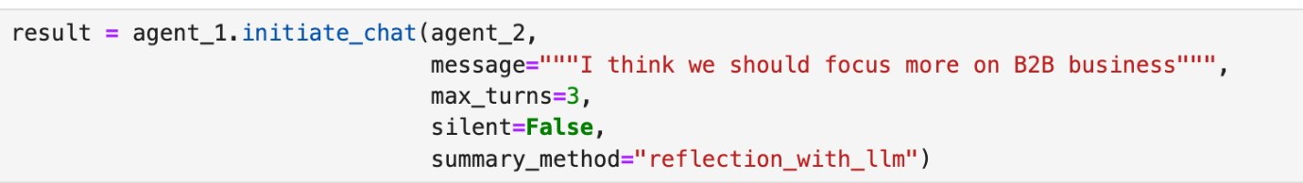
Two Agent Chat
Notes:
Once, the conversation is initialized, the conversation runs for the defined number of turns.

Slide 32
Two Agent Chat
LLM Generated Summary
Notes:
The final step is about Chat Summarization:
Once the chat ends, the summary_method parameter of initiate_chat() defines how the chat history is summarized.
Depending upon our requirements, We can either use the default method: 'last_msg'. Using this, we get the last message as the summary.

Slide 33
Two Agent Chat
LLM Generated Summary
Or use Last message
or
Notes:
Or we can use 'reflection_with_llm’. Using this, we get for LLM-generated summary of the entire conversation. In the conversation agent we had built, we used “reflection_with_llm” to get the summary of the entire conversation at the end.

